Slide 1
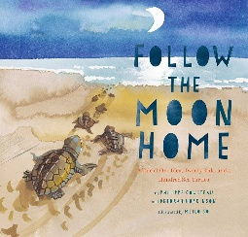
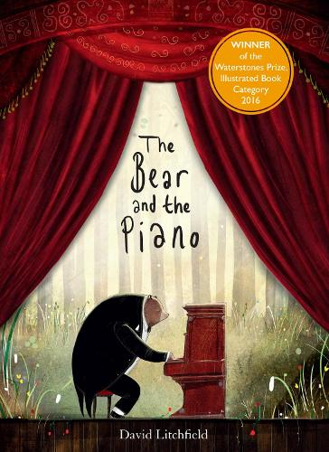
Term 5; Learning in Year 1 and 2 – What does it take to be a great explorer?
History
What does it take to be a great explorer?
Understand what an explorer Is and identify key qualities.
Identify and recognise Columbus
Give an account of Amy Johnson
Describe achievements of Ranulph Fiennes
Explain Neil Armstrongs achievements and Mars challenges.
Literacy
Follow the moon home and Manfish
Biographies and description
Introduce apostrophes
Conjunctions
The bear and the piano
Creative writing
Past and present tense
Coordination and subordination
Valerie bloom’s animal poems
Create noun phrases and write about
Characters.
SPAG year 2;
Adverbs, word classes, coordination, apostrophes, past and present tense.
Science
Plants and seasonal changes part 2
About the changes that happen each season, and the weather that each season brings.
To recognise and name some common plants in the wild, and in our gardens.
To compare and contrast plants, describing their different parts and features.
To observe changes over time as plants grow, including using magnifying glasses.
To draw diagrams and record information in charts tables.
Art
Shape: Use shape in Artwork
Leah Bartholomew
Anthony Gormley
Create art based on different explorers, using shape and inspiration from two artists to create these artworks.
Maths
Number: Fractions:
Parts and wholes, equal and unequal parts
Recognise a quarter, half, three-quarters and third.
Recognise the relationship of a half and two-quarters.
Measurement: Money and Time:
Count money – pence, pounds
Choose notes and coins
Compare and calculate amounts of money.
Understand hours, minutes and seconds. Understand O’clock and half-past, quarter to and quarter past.
RE; year 1
How should we care for others and the world and why does it matter?
RE; year 2
How should we care for others and the world and why does it matter?
Computing; year 1
Creating media – digital writing
Computing; year 2
Creating media – digital music
PE
Athletics part 1
Bikeability
Music
Friendship songs: learn songs off by heart. To know music has a steady pulse, rhythms from words. To know rhythms are different from a steady pulse.
Spanish
Animals, colours and sizes
Enrichment:
Greenwich Maritime Museum.
Music

