Slide 1
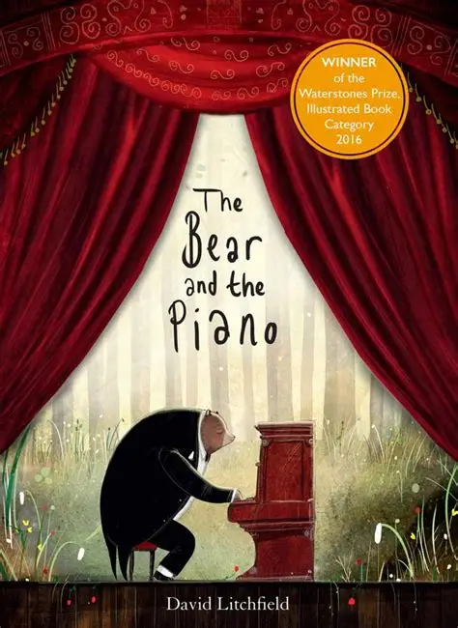
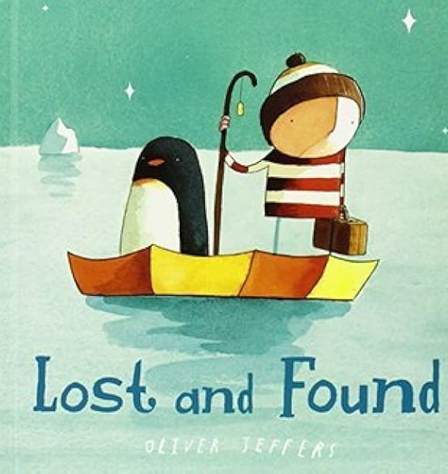
Term 6; Learning in Year 1 and 2 – Why do we like being by the seaside?
Geography
Why do we love being by the seaside?
Physical and human features of seaside environments.
Importance of protecting living things at the seaside.
Describe popular activities.
Identify and describe rock pool habitats.
Seaside holidays through the years
Compare to holiday destinations abroad.
Literacy
Continue The bear and the piano
Oracy
Creative writing
Coordination and Subordination.
The lost and found
Verb forms
Quest stories.
Instructions
Commas in list forms and continue to explore sentence types.
SPAG year 2;
Recapping pronouns
Forming nouns using ‘-er’
Science
Living things and their habitat.
- Recognise whether things are alive, dead or have never lived.
· Identify different plants and animals and recognize that they are suited to their different habitats, including micro-habitats.
· Recognise how different habitats provide for the basic needs of animals and plants.
· Understand that animals get their food from other animals and/or from plants.
· Recognise that a food chain is made of a series of plants and animals that eat each other and shows how energy is transferred from one organism to another via food.
Art
Pointillism
Introduction to Pointillism
Artist Focus: Ana Enshina and George Seurat
Missing and texture through dots
Wildlife artwork in the style of Aboriginal Australian piece.
End of term week of DT
Structures: A chair for the beach.
RE; year 1
Consolidation
RE; year 2
Consolidation
Computing; year 1
Programming - animations
Computing; year 2
Programming - quizzes
Maths
Measurement: Mass, capacity and temperature:
Measure in grams, kilograms.
Compare volume and capacity.
Measure in millilitres, litres.
Temperature Geometry: Position and direction:
Language of position.
Describe movement describe turns and movements.
Consolidation
Music
Pulse, rhythm and pitch in different styles of music.
PE
Continue Bikeability
Sports day practice – Athletics.
PSHE
Following the character education and completing topics based on whole school assemblies..
Spanish
Food and drink
Music

